Slide 1
CPE 445-Internet of Things
Dr. Abbas Javed
Assistant Professor
Department of Computer Engineering,
COMSATS University Islamabad, Lahore Campus
abbasjaved@cuilahore.edu.pk

Slide 2
About the Instructor
Post Doc, LPWAN, 2017
Glasgow Caledonian University, UK.
PhD,IoT, 2016
Glasgow Caledonian University, UK.
MSc Control Systems, 2008
University of Sheffield, UK.
BSc, Computer Engineering, 2006
COMSATS IIT, Lahore, Pakistan.

Slide 3
Motivation:
Company: Punjab Information Technology Board, Govt. of Punjab Website: https://pitb.gov.pk/
Typical Day at Work:
Identifying potential problems in government and private sectors.
Suggesting a viable solution based on latest tech implementation in embedded, electronics and circuit design (Arduino, Raspberry Pi, Adafruit, TI, Hard kernel Odroid).
Integration of different sensor and modules with controllers.
Implementation of pre-trained AI/ML Model, preferably in Computer Vision.
Debugging and testing of electronic circuits and mechanical systems
Continuous improvement of deployed systems (turnstiles, RFID Access System etc.)
You are required to have:
Understanding Datasheets and Specs details.
Knowledge of communication protocols in embedded system (I2C, SPI, UART, Wiegand, USB)
Knowledge of working principle of RF communication (LoRa, NFC, RFID, BLE, Nb-IoT)
Preparing prototypes for pilot project as a proof of concept.• Grasp on Data structure, algorithm and basics of C++/C#/Python.
Hands-on experience of implementing and configuring hardware based solution (CCTV, Access Control, Parking)

Slide 4
Contents
Genesis of IoT: This section highlights IoT’s place in the evolution and development of the Internet.
IoT and Digitization: This section details the differences between IoT and digitization and defines a framework for better understanding their relationship.
IoT Impact: This section shares a few high-level scenarios and examples to demonstrate the influence IoT will have on our world.
Convergence of IT and OT: This section explores how IoT is bringing together information technology (IT) and operational technology (OT).
IoT Challenges: This section provides a brief overview of the difficulties involved in transitioning to an IoT-enabled world.

Slide 5
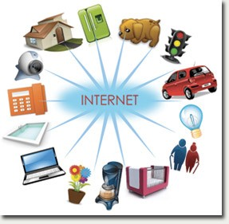
What is IoT?
A phenomenon which connects a variety of things
– Everything that has the ability to communicate

Slide 6
Genesis of IoT
Kevin Ashton created the term “Internet of Things” while working for Proctor & Gamble in 1999
Age of IoT started between 2008 and 2009
The basic premise and goal of IoT is to “connect the unconnected”
IoT is a technology transition in which devices will allow us to sense and control the physical world by making objects smarter and connecting them through an intelligent network
IoT is broad and multifaceted

Slide 7
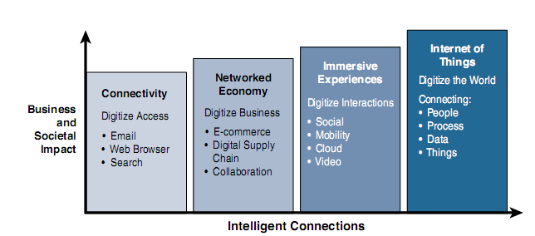
Evolution of IoT

Slide 8
Evolutionary Phases of the Internet
Connectivity (Digitize Access)-This phase connected people to email, web services, and search so that information is easily accessed
Networked Economy (Digitize business)- This phase enabled e-commerce and supply chain enhancements along with collaborative engagement to drive increased efficiency in business processes
Immersive Experiences (Digitize interactions)- This phase extended the Internet experience to encompass widespread video and social media while always being connected through mobility. More and more applications are moved into the cloud
Internet of Things (Digitize the world)- This phase is adding connectivity to objects and machines in the world around us to enable new services and experiences. It is connecting the unconnected

Slide 9
IoT and Digitization
IoT and digitization are terms that are often used interchangeably
IoT focuses on connecting “things,” such as objects and machines, to a computer network, such as the Internet
Digitization can mean different things to different people but generally encompasses the connection of “things” with the data they generate and the business insights that result
Wifi Tracking
Photography, DVD Rental etc.
Transportation Industry- Uber, Careem etc.
Nest

Slide 10
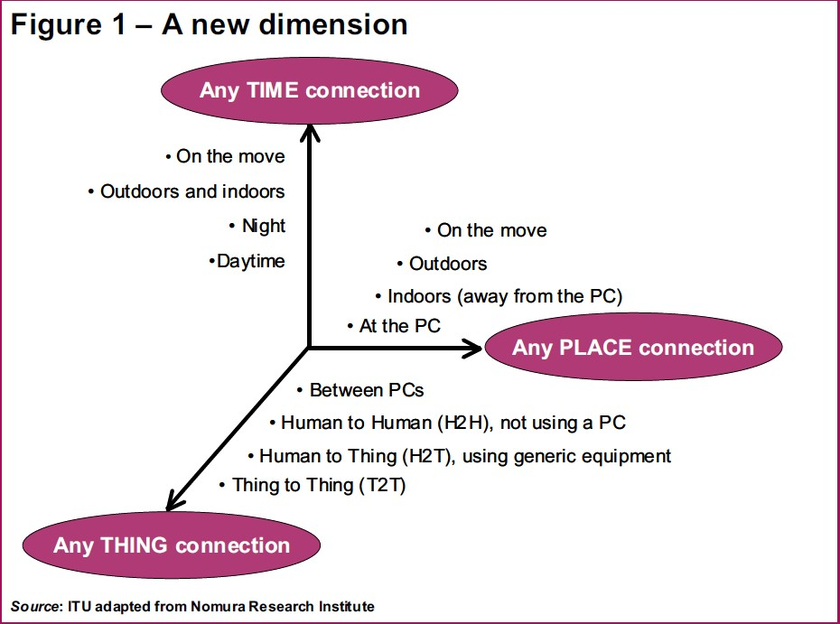
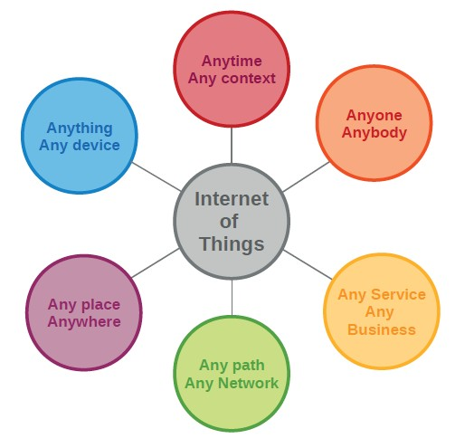
Any-­‐X Point of View
The Internet of Things allows people and things to be connected Anytime, Anyplace, with Anything and Anyone, ideally using Any path/ network and Any service.

Slide 11
Characteristics of IoT
1. Intelligence
– Knowledge extraction from the generated data
2. Architecture
– A hybrid architecture supporting many others
3. Complex system
– A diverse set of dynamically changing objects
4. Size considerations
– Scalability
5. Time considerations
– Billions of parallel and simultaneous events
6. Space considerations
– Localization
7. Everything-­‐as-­‐a-­‐service
– Consuming resources as a service

Slide 12
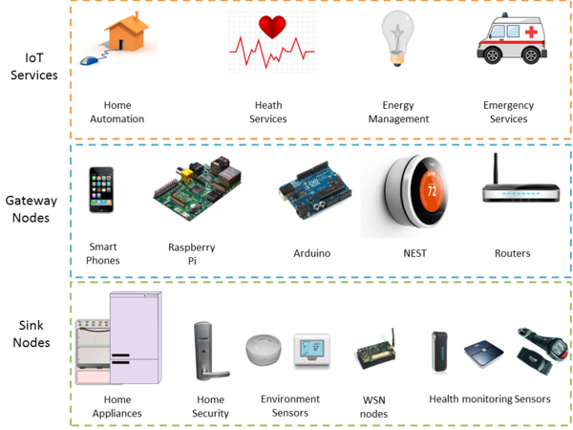
Architecture for Open IoT Services
Source: kno.e.sis

Slide 13
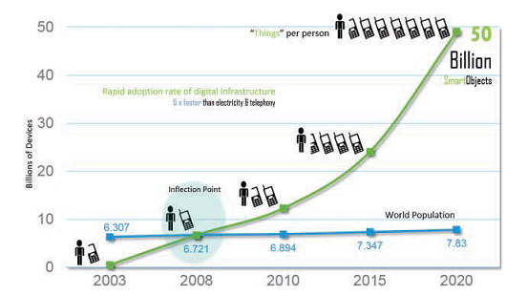
IoT Impact
The Rapid Growth in the Number of Devices Connected to the Internet

Slide 14
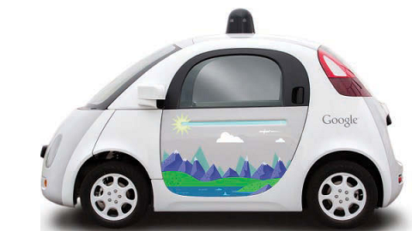
IoT Impact- Connected Roadways
Self-driving vehicles- Google’s self-driving vehicle
Fully connected transportation infrastructure
Self-driving vehicles need always-on, reliable communications and data from other transportation-related sensors to reach their full potential
Google’s Self-Driving Car

Slide 15
IoT Impact- Current Challenges Being Addressed by Connected Roadways
Challenge | Supporting Data
Safety | According to the US Department of Transportation, 5.6 million crashes were reported in 2012 alone, resulting in more than 33,000 fatalities. IoT and the enablement of connected vehicle technologies will empower drivers with the tools they need to anticipate potential crashes and significantly reduce the number of lives lost each year
Mobility | More than a billion cars are on the roads worldwide. Connected vehicle mobility applications can enable system operators and drivers to make more informed decisions, which can, in turn, reduce travel delays. Congestion causes 5.5 billion hours of travel delay per year, and reducing travel delays is more critical than ever before. In addition, communication between mass transit, emergency response vehicles, and traffic management infrastructures help optimize the routing of vehicles, further reducing potential delays
Environment | According to the American Public Transportation Association, each year transit systems can collectively reduce carbon dioxide (CO₂ ) emissions by 16.2 million metric tons by reducing private vehicle miles. Connected vehicle environmental applications will give all travelers the real-time information they need to make “green” transportation choices

Slide 16
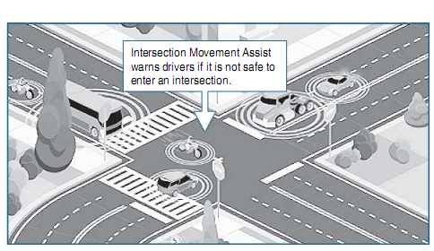
IoT Impact- Connected Roadways
Application of Intersection Movement Assist

Slide 17
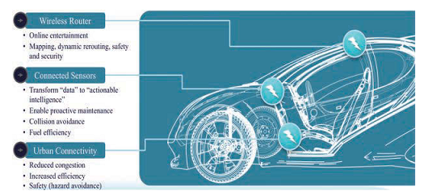
IoT Roadmap-Connected Car
The Connected Car

Slide 18
How much data will be generated by a connected car?
25 GB per hour

Slide 19
IoT Impact-Connected Roadways
Few other applications of IoT for roadways are:
Vehicle Tracking: a vehicle’s location is used for notification of arrival times, theft prevention, or highway assistance
Cargo Management: Cargo management provides precise positioning of cargo as it is en route so that notification alerts can be sent to a dispatcher and routes can be optimized for congestion and weather
Road Weather Communication: Road weather communications use sensors and data from satellites, roads, and bridges to warn vehicles of dangerous conditions or inclement weather on the current route

Slide 20
IoT Impact: Connected Factory
Challenges facing manufacturing in a factor environment
Accelerating new product and service introductions to meet customer and market opportunities
Increasing plant production, quality, and uptime while decreasing cost
Mitigating unplanned downtime (which wastes, on average, at least 5% of production)
Securing factories from cyber threats
Decreasing high cabling and re-cabling costs (up to 60% of deployment costs)
Improving worker productivity and safety

Slide 21
IoT Impact: Connected Factory
Convergence of factory-based operational technologies and architectures with global IT networks is referred to as the connected factory
Large number of sensors are already used in factories. With IoT, these sensors are becoming advanced and attaining new level of connectivity (mainly using Internet Protocol (IP))
Devices on plant floor transmit and receive large quantities of real-time informational and diagnostic data
Connected Factory Examples:
“machine-to-people” connections are implemented to bring sensor data directly to operators on the floor via mobile devices
real-time location system (RTLS) utilizes small and easily deployed Wi-Fi RFID tags that attach to virtually any material and provide real-time location and status

Slide 22
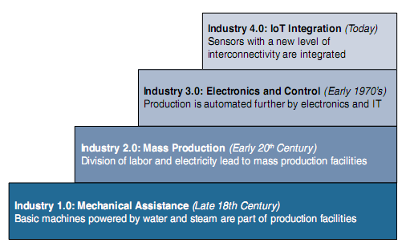
IoT Impact: Industry Revolution
The Four Industrial Revolutions

Slide 23
Industry 4.0
Industry 4.0 takes manufacturing from a purely automated assembly line model of production to a model where the machines are intelligent and communicate with one another
People and machines work together to analyze the data and make intelligent decisions
Machines predicting failures and self-healing
Human monitoring and intervention are no longer necessary

Slide 24
IoT Impact- Smart Connected Buildings
De facto communication protocol responsible for building automation is Building Automation and Control Network (BACnet)
Ethernet-based communication between building devices such as HVAC, Lighting, Access Control, and fire detection systems.
BACnet interfaced with IP network will allow the “things” in the building network to communicate over IP

Slide 25
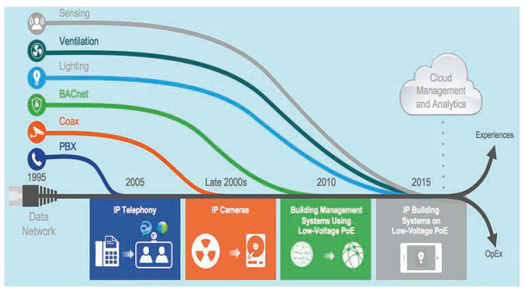
IoT Impact- Smart Connected Buildings
Convergence of Building Technologies to IP

Slide 26
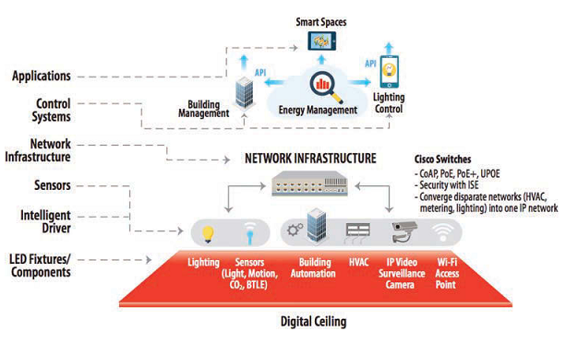
IoT Impact- Smart Connected Buildings
A Framework for the Digital Ceiling

Slide 27
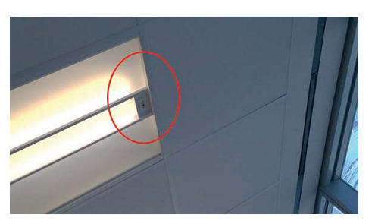
Smart Connected Building- LED Digital Ceiling
An LED Digital Ceiling Light with Occupancy Sensor attached, providing control and power over the same infrastructure
most modern LED ceiling fixtures support occupancy sensors
modern lighting sensors integrate a variety of occupancy-sensing technologies, including Bluetooth low energy (BLE) and Wi-Fi
An LED Digital Ceiling Light with Occupancy Sensor

Slide 28
IoT Impact: Smart Creatures
Connected Cows-Sparked, a Dutch company, developed a sensor that is placed in a cow’s ear. The sensor monitors various health aspects of the cow as well as its location and transmits the data wirelessly for analysis by the farmer
200 MB data per year- needs infrastructure for data
Researchers at North Carolina State University are working with Madagascar hissing cockroaches in the hopes of helping emergency personnel rescue survivors after a disaster.
An electronic backpack attach with roach stimulate the cerci which makes cockroach to move forward.

Slide 29
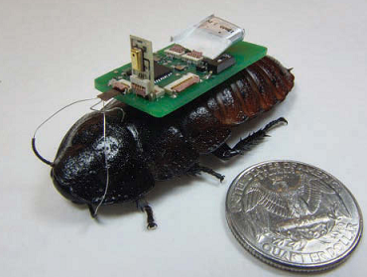
IoT-Enabled Roach Can Assist in Finding Survivors After a Disaster
(Photo courtesy of Alper Bozkurt, NC State University)
https://www.youtube.com/watch?v=gmbEX7zDzog

Slide 30
Comparing OT and IT Network
Criterion | Industrial OT Network | Enterprise IT Network
Operational focus | Keep the business operating 24x7 | Manage the computers, data, and employee communication system in a secure way
Priorities | 1. Availability 2. Integrity 3. Security | 1. Security 2. Integrity 3. Availability
Types of data | Monitoring, control, and supervisory data | Voice, video, transactional, and bulk data
Security | Controlled physical access to devices | Devices and users authenticated to the network
Implication of failure | OT network disruption directly impacts business | Can be business impacting, depending on industry, but workarounds may be possible
Network upgrades (software or hardware) | Only during operational maintenance windows | Often requires an outage window when workers are not onsite; impact can be mitigated
Security vulnerability | Low: OT networks are isolated and often use proprietary protocols | High: continual patching of hosts is required, and the network is connected to Internet and requires vigilant protection

Slide 31
Convergence of IT and OT
More efficient and profitable business
Lower costs through economy of scales
Reduced inventory and improved delivery times
With IT/OT convergence, IoT becomes fully supported by both groups.
“best of both worlds” scenario, where solid industrial control systems reside on an open, integrated, and secure technology foundation

Slide 32
IoT Challenges
Challenges | Description
Scale | While the scale of IT networks can be large, the scale of OT can be several orders of magnitude larger. For example, one large electrical utility in Asia recently began deploying IPv6-based smart meters on its electrical grid. While this utility company has tens of thousands of employees (which can be considered IP nodes in the network), the number of meters in the service area is tens of millions. This means the scale of the network the utility is managing has increased by more than 1,000-fold!
Security | With more “things” becoming connected with other “things” and people, security is an increasingly complex issue for IoT. Your threat surface is now greatly expanded, and if a device gets hacked, its connectivity is a major concern. A compromised device can serve as a launching point to attack other devices and systems. IoT security is also pervasive across just about every facet of IoT
Privacy | As sensors become more prolific in our everyday lives, much of the data they gather will be specific to individuals and their activities. This data can range from health information to shopping patterns and transactions at a retail establishment. For businesses, this data has monetary value. Organizations are now discussing who owns this data and how individuals can control whether it is shared and with whom

Slide 33
IoT Challenges
Challenges | Description
Big data and data analytics | IoT and its large number of sensors is going to trigger a deluge of data that must be handled. This data will provide critical information and insights if it can be processed in an efficient manner. The challenge, however, is evaluating massive amounts of data arriving from different sources in various forms and doing so in a timely manner
Interoperability | As with any other nascent technology, various protocols and architectures are jockeying for market share and standardization within IoT. Some of these protocols and architectures are based on proprietary elements, and others are open. Recent IoT standards are helping minimize this problem, but there are often various protocols and implementations available for IoT networks. The prominent protocols and architectures—especially open, standards-based implementations

Slide 34
Summary
IoT is about connecting the unconnected, enabling smart objects to communicate with other objects, systems, and people
High-level use cases discussed to show the impact of IoT
Difference between IoT and Digitization was discussed
Challenges faced by IoT

Slide 35
• Active mode (AM)
– All clocks are active
• Low-power mode 0 (LPM0)
– CPU is disabled
– ACLK and SMCLK remain active, MCLK is disabled
– FLL loop control remains active
• Low-power mode 1 (LPM1)
– CPU is disabled
– FLL loop control is disabled
– ACLK and SMCLK remain active, MCLK is disabled
• Low-power mode 2 (LPM2)
– CPU is disabled
– MCLK and FLL loop control and DCOCLK are disabled
– DCO's dc-generator remains enabled
– ACLK remains active
• Low-power mode 3 (LPM3)
– CPU is disabled
– MCLK, FLL loop control, and DCOCLK are disabled
– DCO's dc generator is disabled
– ACLK remains active
• Low-power mode 4 (LPM4)
– CPU is disabled
– ACLK is disabled
– MCLK, FLL loop control, and DCOCLK are disabled
– DCO's dc generator is disabled
– Crystal oscillator is stopped
– Complete data retention

